Slide 1


Course Info
Time: MWF 9:10-10:00 AM
Location: CHEN 106
Instructor: Hung-Jen Wu
Office: CHEN 227
Phone: (979) 862-1454
Email: hjwu@tamu.edu
Office Hours
MW 10:00-11:00 AM
By appointment
Teaching Assistant: Beth Wei
Office: TBA
Email: bettywey@tamu.edu
Office Hours
TBA
Message brought to you by Python gang
Category | Date | Percentage
Practice Quizzes | N/A | 15%
Pop Quizzes | N/A | 5%
Homework | N/A | 15%
Midterm 1 | Sep 27th | 20%
Midterm 2 | Nov 13th | 20%
Final | Dec 6th 8:00-10:00 | 20%
Reflection Letter | TBA | 5%

Slide 2
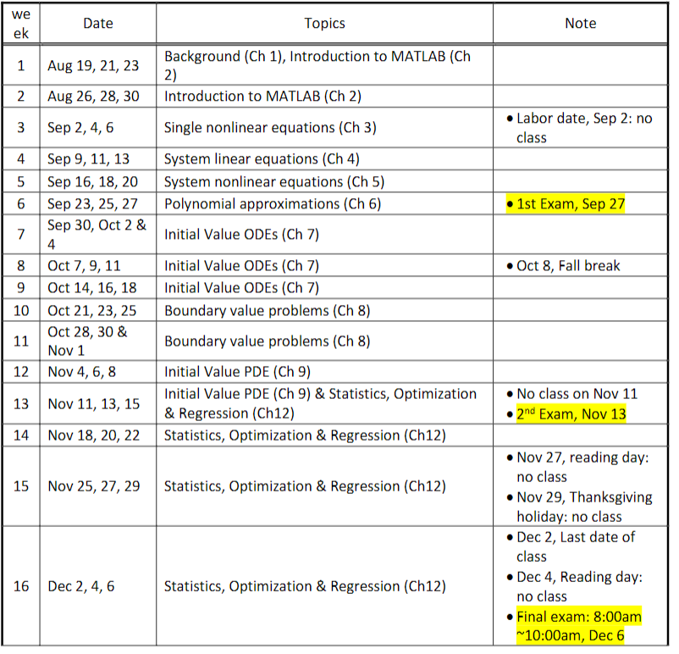

Slide 3
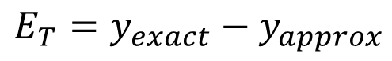
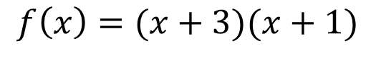
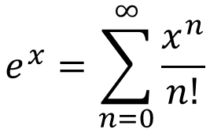
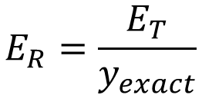
Chapter 1: Introduction
Issues for computational methods
Convergence
The way we try to solve problems is through iterations, so we must make an initial guess to solve it. If the guess doesn’t work out, we must make another guess. A good numerical method will converge to the answer we want.
Accuracy
The answers we get must be correct. Usually expressed by the number of significant digits
Stability
Like convergence, but for differential equations, stability has a different meaning. Will be covered when we get there
Computational Efficiency
Most questions are simple in this course, but large-scale simulations can cause issues, so efficiency is necessary.
Example Problem:
$$f\left(x\right)=(x+3)(x+1)$$
A numerical analysis solution could test points what you give it, and from there, find the answer.
Numerical Error
Total error: difference between the true value and the numerical approximation.
$$E_{T}=y_{exact}−y_{approx}$$
Relative error: Total error over the exact answer
$$E_{R}=\frac{E_{T}}{y_{exact}}$$
These are not practical, because would you find the numerical approximation, if you already know the answer?
Truncation errors: Difference between the exact value and the power/Taylor series expansion with a finite number of terms
$$e^{x}=\sum_{n=0}^{∞}{\frac{x^{n}}{n!}}$$

Slide 4
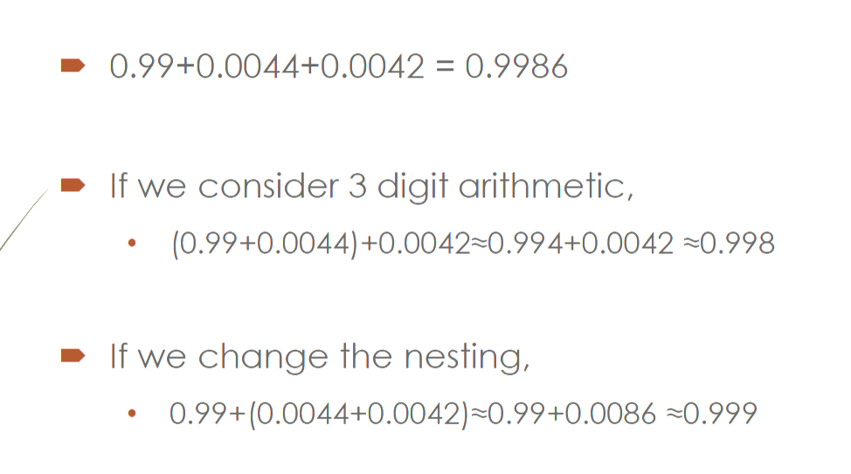
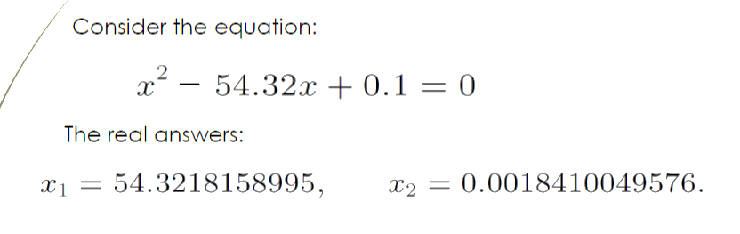
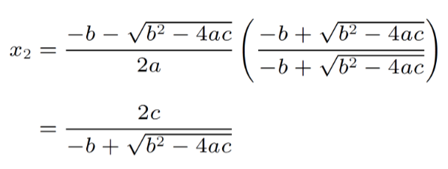
Computer related stuff
Round-Off Error: comes form computer itself
Computers can only hold a certain number of digits
Digits left off by the computer are called round off errors.
Round off error can make a significant impact when subtracting two very close numbers
Suppose your computer can only hold 3 sig digits
Precision (floating point format)
Single (32 bits): ~7 sig digits
Double (64 bits): ~15 sig digits
MATLAB uses double by default, so to get single, you will have to specify
Triple precision is possible with 128 bits
Cancellation error: comes when there is a massive difference between the expected and calculated answers
EX: consider a situation when your square root function only goes to 4 digits
One solution is only off by 0.04%, but due to a cancelation error, the other one is off by 100%
You can reformulate the equation to get a better answer
This may not be very useful now because most function in the computer have a higher accuracy, but later, for differential equations, this becomes more useful

Slide 5
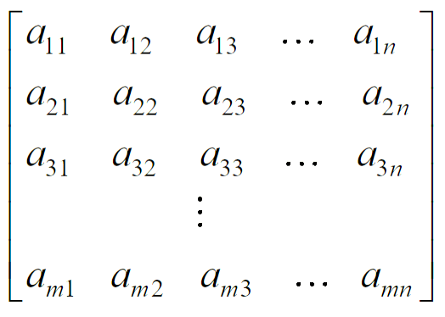
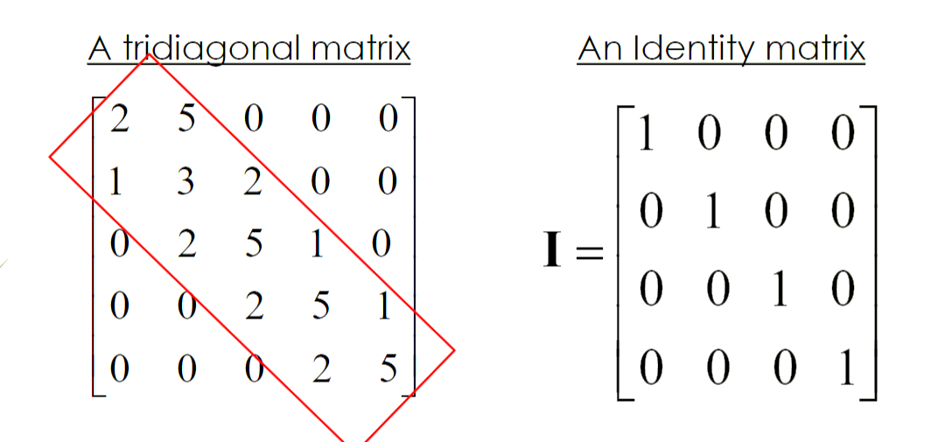
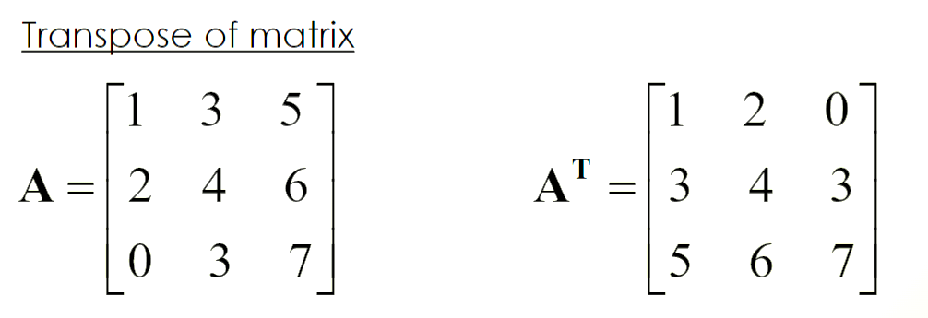
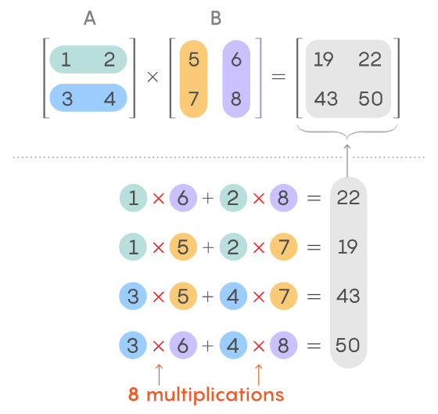
Fundamental mathematics to know: Vectors and Matrices
A matrix is characterized by the number of rows and columns it has. Rows are the horizontal elements and columns are the vertical elements.
General matrix with m rows and n columns
Matrix Operations
Matrix Equality: (A = B) means that A and B have the same number of columns and rows, and the values in the same positions are the same
Matrix Addition: (A + B = C) means that A and B had the same numbers or rows and columns, and C is the values in the same positions in A and B added together
Matrix Multiplication: The element in the resulting matrix is found by doing the scalar product for the values in the original matrices of the same column and row.
The first matrix should have as many rows as the second has columns

Slide 6
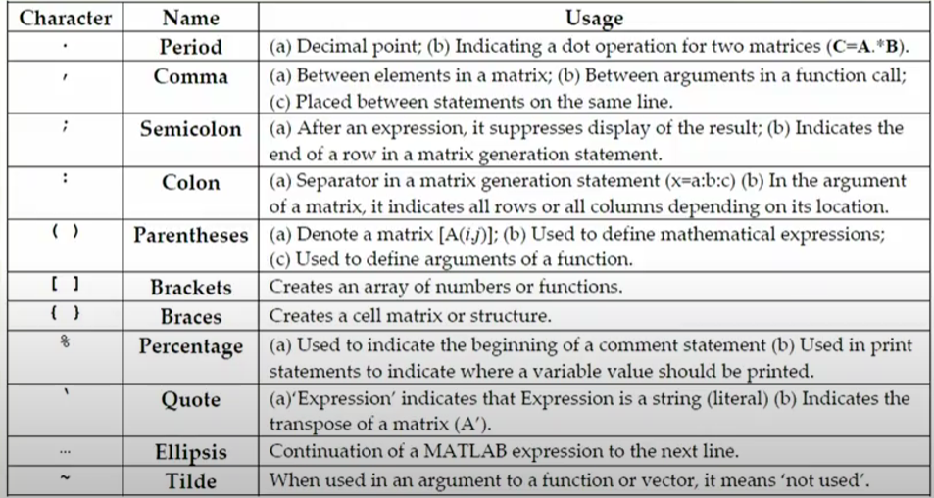
Chapter 2: MATLAB
Variables
Can store numbers, strings or unknown quantities
Variable names operate like python, assignments are like python as well
Globally defined
Floats are double by default
Operators
‘+’ addition
‘-’ subtraction
‘*’ multiplication
‘/’ division
‘^’ exponentiation
Syntax special variables
‘ans’ used to store the result of an expression
‘clock’ variable that contains the current time
‘date’ contains the current day
‘i’ sqrt(-1)
‘Inf’ when a number exceeds the maximum or minimum number
>1.7E308 or <-1.7E308
‘j’ sqrt(-1)
‘NaN’ stands for not a number
Usually, the result of an undefined math operation (0/0 or log(-2))
‘pi’ pi to 15 sig digits

Slide 7
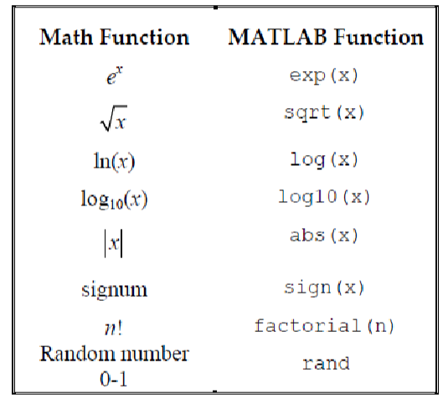
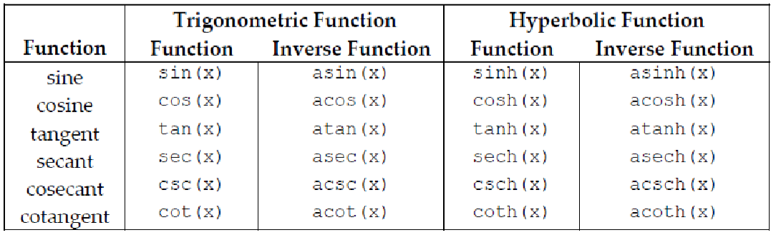
Some Tips
Use a semicolon at the end of a line to prevent it from printing on the command line
Use ‘%’ to comment
Use ‘%%’ to designate sections

Slide 8
Matrices and Vectors
Transposing Vectors
v = v’
v = transpose(v)
Some Vector info
Get a certain value from a vector
v(index)
Indices start at 1, not 0
Max and min
[value, index] = max(v)
[value, index] = min(v)
Length
v_length = length(v)
Creating vectors
Creating a row vector: v = [1, 2, 3]
Creating a column vector: v=[1; 2; 3]
Creating a larger vector:
v = [start:step:stop]
The stop is inclusive
v = Linspace(start, stop, # of indices)
Creating Matrices
M = [1, 2, 3; 4, 5, 6]
To make matrices easier to read in the code, use ‘…’ after the row, and proceed to the next row. This will make it, so your matrix looks as it functions in the code.
You can also create them by using vector variables
M = [r1; r2; r3]
Or you can make them with a collection of columns
M = [c1, c2, c3]
Vector with sequences:
M = [start:step:stop; …]
Vector with all 1’s or 0’s
M = ones(height, width)
M = zeros(height, width)
Identity matrix
M = eye(size)
Accessing info from matrices
M(row, column)
Retrieving a row or column
M(row, :)
M(:, column)
Getting the size of a matrix
result = size(M)
Given as ‘rows columns’
Transposing Matrices
Same as Vectors
Max and min of matrices
You need to take the max / min twice to get the actual maximum/minimum of the matrix twice
max_val = max(max(matrix))

Slide 9
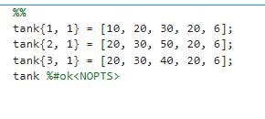
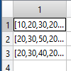
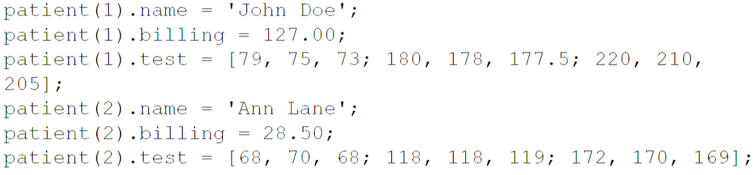
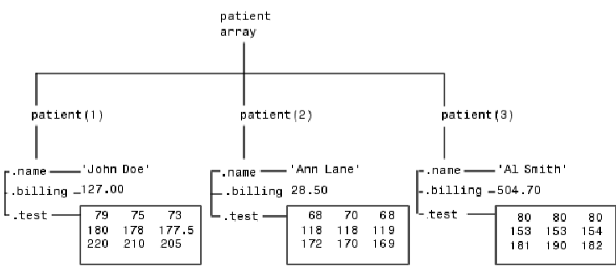
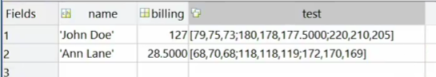
Cell Arrays
Can hold any data type and data in the cells can differ in type
Like a list of lists from python
Useful Applications:
When you have many instances of a similar structure of data
EX: you have 100 reactors and don’t want to individually define all of them
Creating Cell Arrays
cell_array{row, column} = (any type of data)
Structured Arrays
Organize data and access it by name
Like a cell array but the second dimension is not just an integer, but a way to name the data
Like a python dictionary

Slide 10
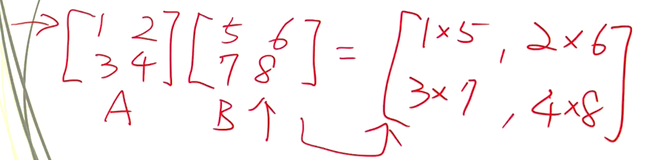
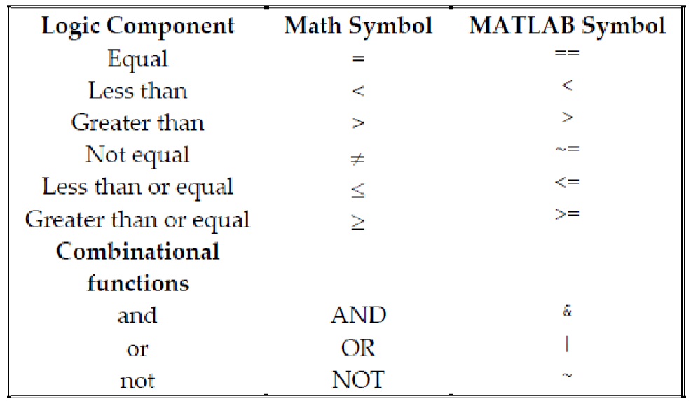
Common Operations
Importing Data:
csvread: reads a csv file
M = csvread(filename)
We will mainly use this function for importing data
xlsread: reads excel file
Don’t use this, it works for older spreadsheets
readcell: new version for reading excel file
Dot Operations:
Allows you to combine two matrices in a variety of ways
‘.*’ will multiply the elements of two matrices together
‘./’ will divide the elements of the first matrix by the second matrix
‘.^’ will raise the elements of the first matrix by the second matrix
All these work with scalars

Slide 11
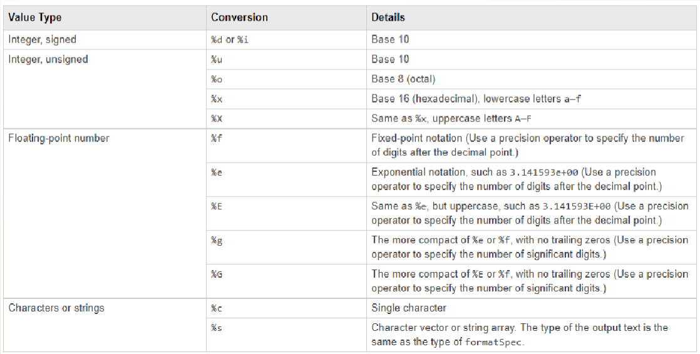
Logic
While Loops
while condition
code
end
For loops
for iterable
code
end
Iterables take the form i = start:step:stop
If Else Statements:
If condition
Code to execute
elseif condition
Code to execute
else
Code to execute
end
break and continue are available for loops
Output
Copying values from MATLAB into excel is possible
Just open the spreadsheet menu and copy and paste
Also, downloading .mat files for a single variable or all variables in your workspace is possible
fprintf(formatted string)
Can use this to format your outputs (like an f string)
Can put multiple variables in a string
Use ‘\n’ to jump to the next line

Slide 12
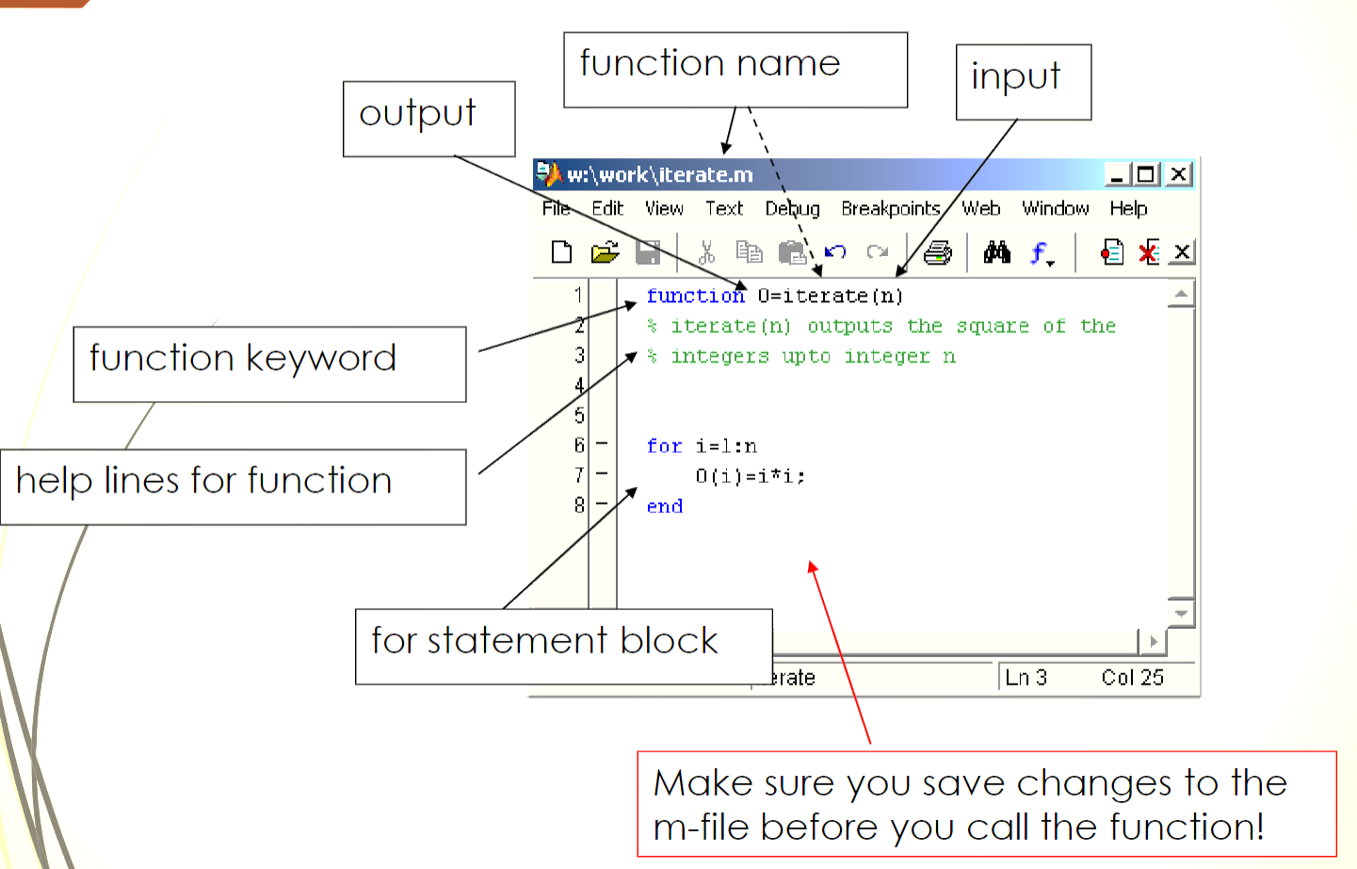
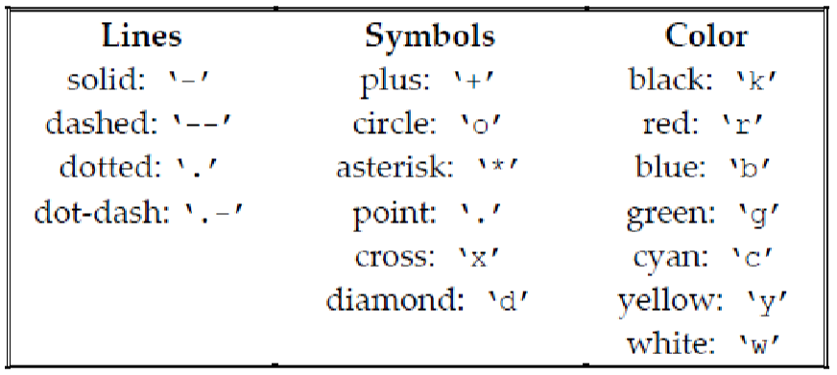
m-files
Used for creating functions\
Anonymous functions (Lambda functions)
Takes the form: function_name = @(var1, var2…) function
Actual functions as files
Functions can have multiple outputs. To take advantage of this, use a vector [var1, var2]
Useful for large amounts of code
Plotting
plot(x, y) creates quick, dirty plots
Some formatting can easily be applied to make your plots better

Slide 13
Plot formatting
plotted_data = plot(x_data, y_data)
To put multiple data sets on a plot, use ‘hold on’ after the first one
set(plotted_data, ‘Color’, [R, G, B]) The RGB values are normalized to 1
set(plotted_data, ‘LineStyle’, ‘-’)
to change bounds
xlim([start, stop])
ylim([start, stop])
to change axis labels
xlabel(‘name’, ‘FontSize’, int)
xlabel(‘name’, ‘FontSize’, int)
Title:
title(‘title’, ‘FontSize’, int)
Legend:
Legend(‘name for first graphed data’, …)
Symbolic Toolbox
defining symbolic variables
syms var
To do fractional math without decimal points
sym(frac)
Simplify functions
expand(sym_func)
simplify(sym_func)
substitute values in a symbolic function
subs(sym_func, [var1, var2, …], [val1, val2, …])
Factor polynomials
factor(sym_func)
Convert to anonymous function
matlabFunction(sym_func)
Derivatives/Integrals
diff(sym_func, var, order)
int(sym_func, var): indefinite
int(sym_func, var, from, to) definite
can use symbolic variables for form and to
What if your integral has no easy solution?
vpa(integral)
These functions do not change the existing variable, make sure to assign new variables when making them

Slide 14
Some other functions that are useful
lower(str) -> returns the string but in all lowercase
error(message) -> raises an error

Slide 15
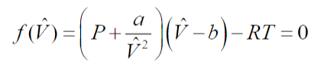
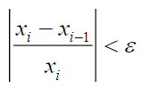
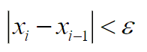
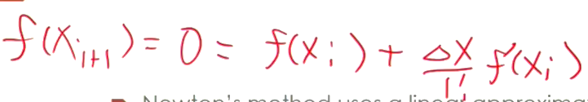
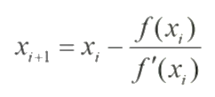
Chapter 3: Single Variable Nonlinear Equations
Ideal Gas law is an example of a nonlinear equation
First way of solving a single nonlinear equation:
In this example, the Van Der Waals equation of state was manipulated to be equal to zero. Now you can solve for the needed variable through trial and error
This way is not very efficient for solving these types of problems
Also, this cannot be solved for equation
For iterative solutions:
When finding out when to terminate an iterative solution, a test needs to be applied
Normally, the relative change is used:
For solutions near zero, a different criteria is used:
Note: use the x value, not the value of the function for the ahead methods
Newton’s Method
Uses Truncated Taylor series expansion after 2 terms to find the next term
Solves for where f(x) = 0
If multiple roots exist, the slope determines which one will be found. You will have to use multiple starting points
Sometimes your answer will converge, other times it will diverge. It depends on what the character of the graph looks like and what starting point you choose

Slide 16
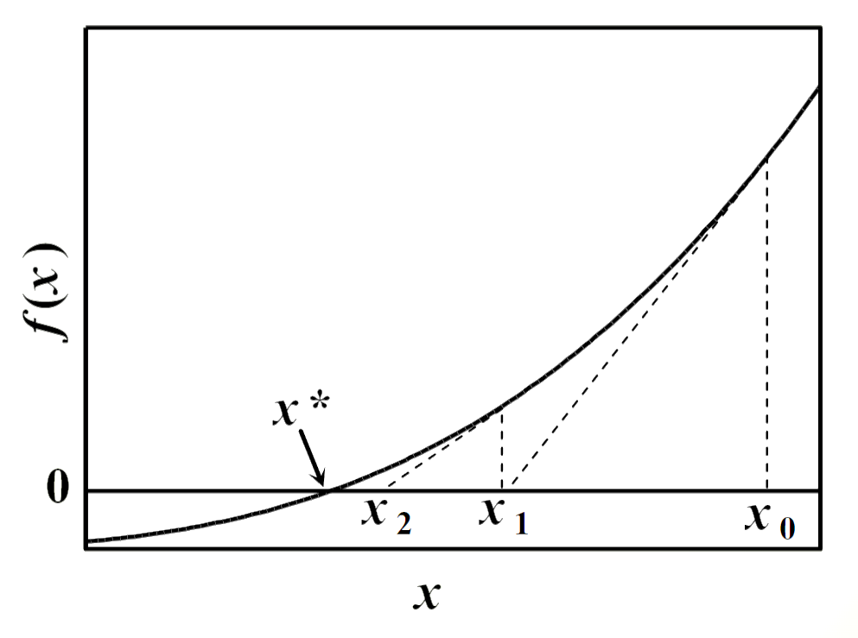
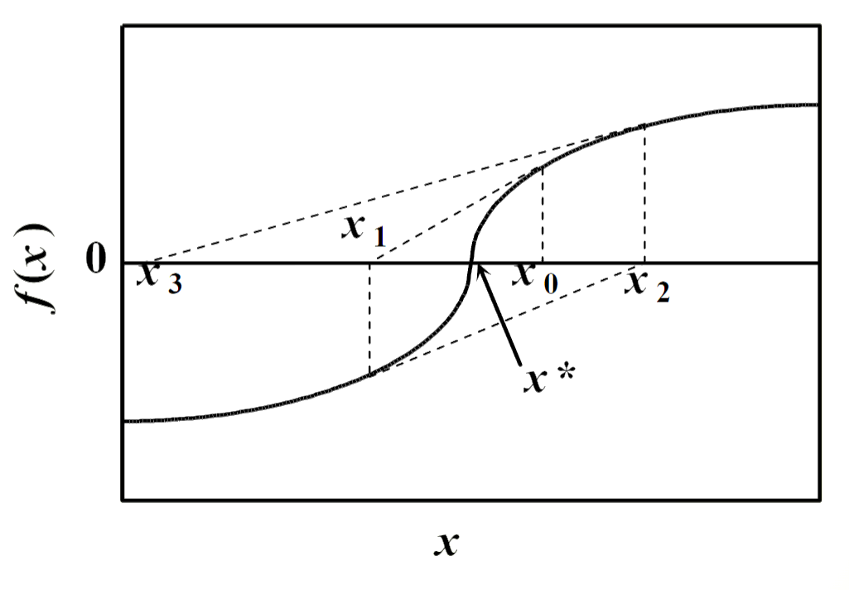
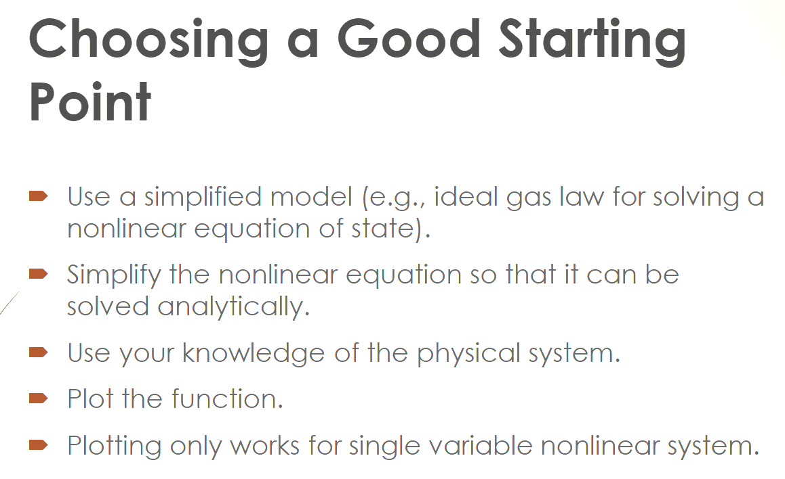
Converging
Example
Diverging
Example
For this equation, Newton’s method can’t be used

Slide 17
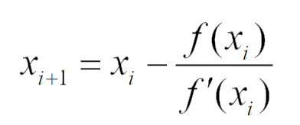
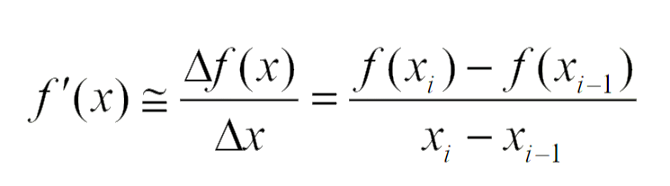
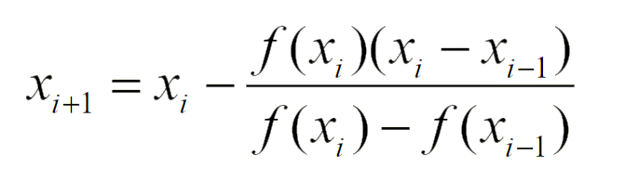
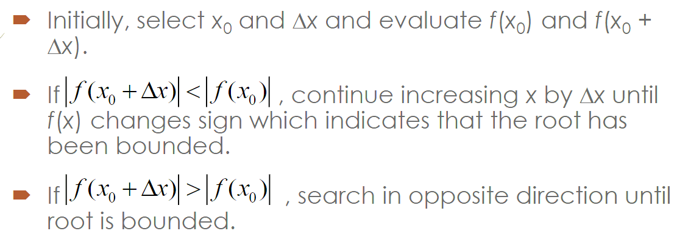
Secant Method
Instead of finding f’(x), we will use the finite difference
Good for equations that have if statements (piecewise)
Need two guesses, but you can just choose one close to your first
Bounding Method
Preferable to Newton’s method for solving single variable nonlinear equations
Three major bounding methods:
Bisection method
Regula False method
Illinois method
Only doesn’t work when the point passes through zero but doesn’t cross into the other side of the axis EX: f(x) = x²

Slide 18
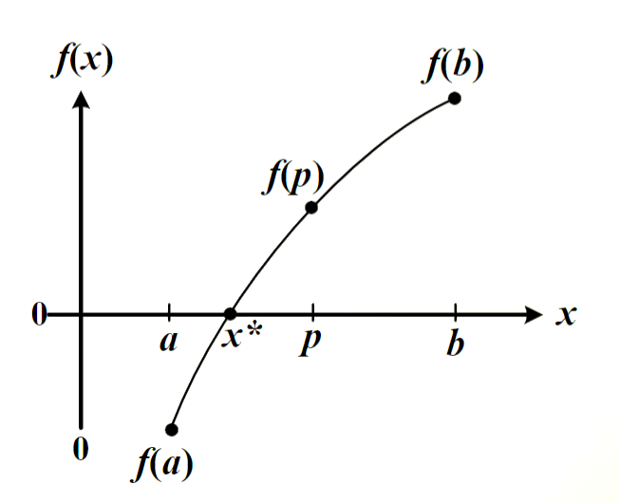
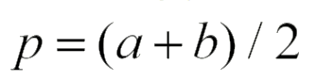
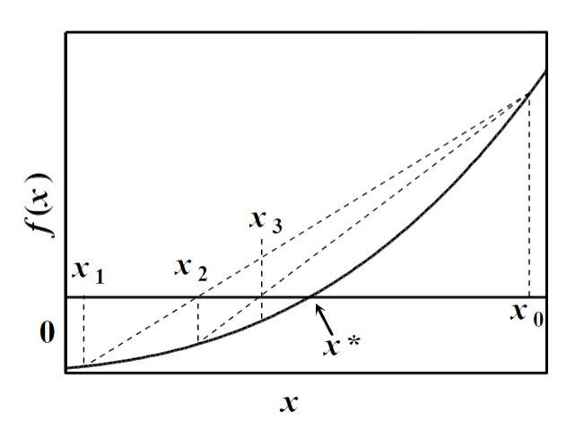
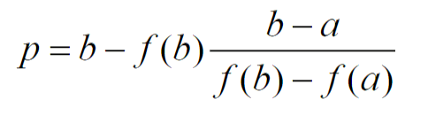
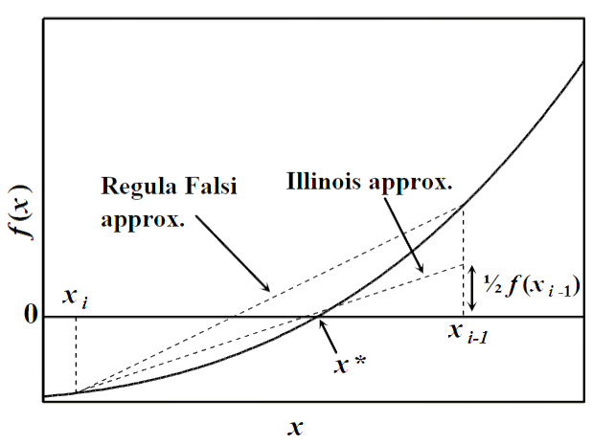
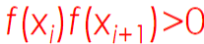
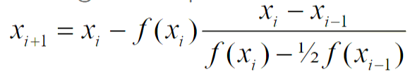
Bisection Method
Once an a and b are found such that the root is in between them, the midpoint is found and calculated
P replaces whichever point had the same sign as f(p)
For this method, error would be the difference between the two points
P would replace b in this instance
Regula Falsi Method
The next point is found by applied based on the secant method
Slow convergence for highly nonlinear functions
Illinois Method
Modification of the Regula Falsi method
Follows the Regula Falsi method, except when
Then they use
The fzero function in MATLAB uses a mix of the bisection and Illinois method

Slide 19
MATLAB Function - fzero
Syntax:
x = fzero(f, x0, options)
f is the function handle (anonymous function or function file)
When using a function file, you must put @ before the name
x0 is the initial guess
Only one guess because the computer find the other one
Sometimes you can find issues with this where the search for a second x will cross 2 solutions at once, but the computer has no idea it did that
another option is to send in a vector with custom bounding
EX: [lower_bound, upper_bound]
Options are some manual settings you can set
Ex: options = optimset(‘’TolX’, tolerance, ‘Display, ‘iter’)
tolerance must be set in scientific notation in the form {num}e{int}
‘iter’ will display the number of iterations
x is the solution
Has a relative convergence criteria of 10^-6, which usually provides 5 sig figs of accuracy
Solve function (symbolic)
Same built in tolerance as fzero
When outputting, make sure to convert to a float by using the double(value) or vpa(value) function
Will locate all roots, so no starting point is needed
Syntax:
x = solve(symbolic function, symbolic variable)
If you want to set the function equal to something, use ==
When solving these types of problems (Chap 3), If you have an opportunity to reformulate an equation so you don’t have your variable in the denominator, Do it

Slide 20
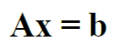
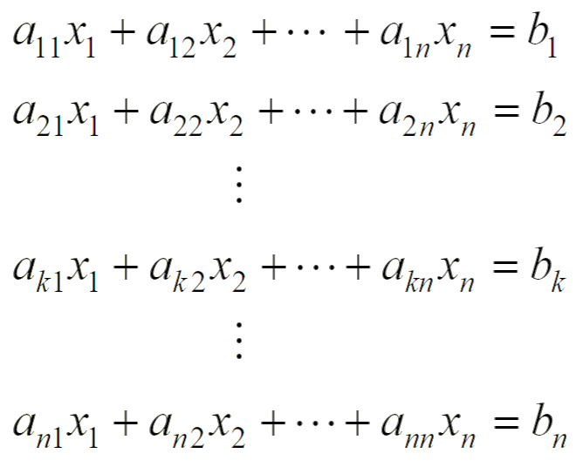
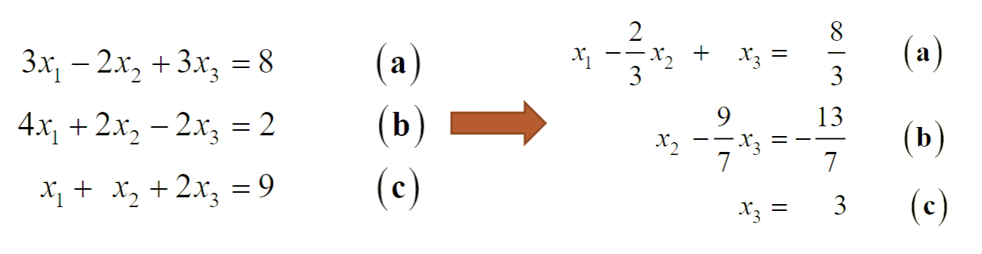
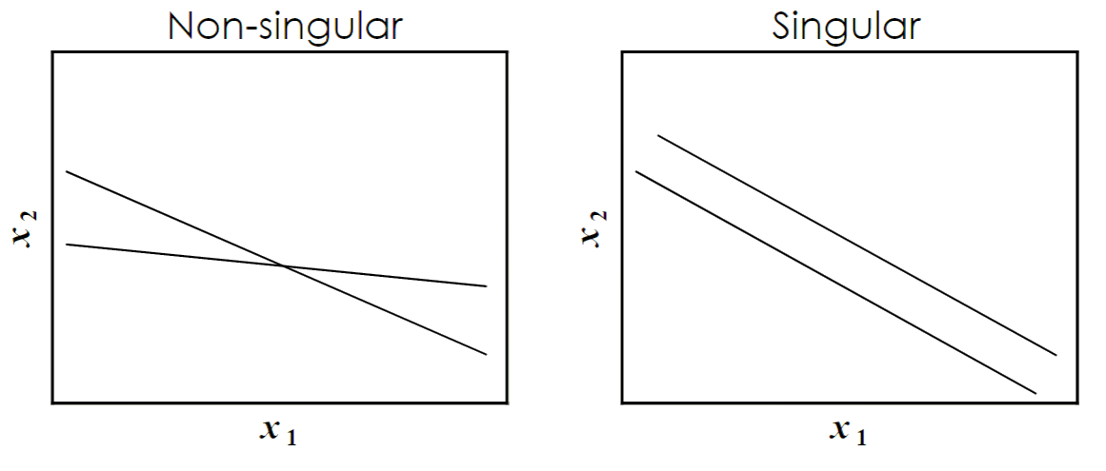
Chapter 4: Systems of linear equations
Takes the form
x is a column vector with the number of variables
B is a column vector with all the solutions
A is a square matrix with one side having the
same length as the x and B column vectors
(also referred to as the coefficient matrix)
For these problems, round off error will impact the accuracy of the answers
For large problems, computational efficiency is key
Gaussian Elimination
This is the classic way of solving these types of problems. There are two steps:
1. Forward elimination where a variable is eliminated until there is only one remaining
2. Backwards substitution where you go back through the equations to find the value for each variable
(Round off error can come into effect during this part of the problem solving because with large systems, they can stack on one another when going backwards)
For systems of linear equations, there are two cases. One where all the equations generated by the matrix multiplication are independent (non-singular), and one were some or all the equations are dependent on each other (singular)
There’s no solution for singular systems

Slide 21
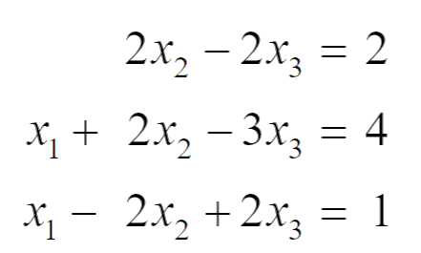
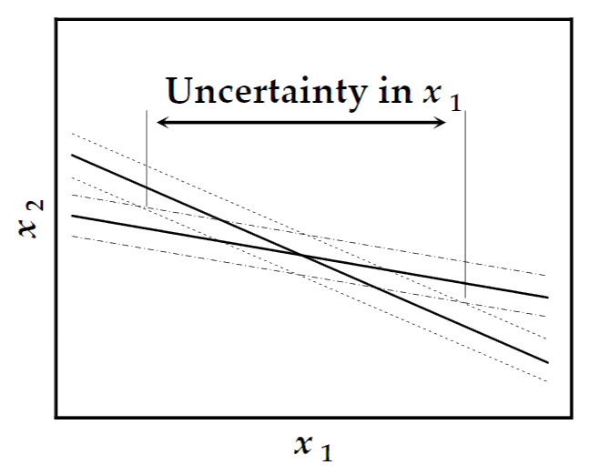

Problems with Gaussian Elimination
1. cannot eliminate an unknown:
You cannot eliminate x1 with the first equation because the coefficient is 0
This problem is easily solved by row pivoting (switching order of equations)
MATLAB has a built-in function ‘\’ to solve this issue
2. Ill conditioning
sometimes there is a large overlap in uncertainties when solving for a variable
This happens when the slopes approach each other slowly.
This amplifies the round-off-error (the main problem)
Another issue with Ill Conditioning:
When eliminating, you can have problems when equations have completely different magnitudes
This can be solved by scaling, which is multiplying the equation by a constant to make them similar in magnitude
you have to do this on your own

Slide 22



MATLAB functions for linear systems of equations
A banded Matrix has many 0’s and leads to easier solving, but computers can have issues with it. This function doesn’t have an issue with it
LU decomposition
Benefits:
after finding L^-1B,
you can start backwards
substituting immediately
useful for when the B
vector varies but A remains
the same (not as a function,
but you must use A to solve multiple different B’s)
Reduces computation and increases speed, but not necessary if your computer is good enough

Slide 23



Condition Number – can be used to determine ill conditioning
Gauss-Seidel Method
Gauss-Seidel is good for computer efficiency, but likely not needed in our case

Slide 24

0 is the initial guess
Solving linear equation with symbolic toolbox
solve function
Just enter the equations separated by commas
Solve(eq1(x1,x2,x3), eq2(x1,x2,x3), eq3(x1,x2,x3), x1, x2, x3)
You can use unspecified constants that are symbolic variables
What this function is the most useful for
Takes significantly more computing power than backslash

Slide 25



Chapter 5: Systems of nonlinear equations
Bounding method doesn’t work, so we need to use Newton’s method. (also, secant method doesn’t work)
In addition, plotting a function will not be able to help you solve a solution
Example of a system of nonlinear equations
This one can be graphed, but more complex systems won’t be able to.
Numerical way of solving systems of equations
Newtons method is based off Taylor Series, so let's review that

Slide 26





For our purposes, we will be using the first term of the Taylor series expansion
Developing our solution
We are going to use this as an example
First, we must make an estimation (let’s say x1 = 4 and x2 = 2)
Using the first term of the Taylor series expansion

Slide 27







Because f1 and f2 = 0
Now, we solve this system on non-linear equations
Now repeat at these new x values until convergence
This is Newton’s method for a k amount of equations
A matrix
(Your partial derivatives at your previous x values)
Also known as the Jacobian
x matrix
b matrix
(the values of your functions at the previous x values multiplied by negative one)

Slide 28


Your A matrix is also known as the Jacobian
You can find the equation using the symbolic toolbox
Your functions
The values of these variables to find the Jacobian at
To get the MATLAB function version of your Jacobean (this is useful because the Jacobian gives a symbolic solution) use:
your_func = matlabFunction(symbolic_eq)
This returns an anonymous function
The built in Newton’s Method function (fsolve) uses finite difference to find the Jacobian
Some notes on Newton’s Method:
Can solve 95% of nonlinear systems of equations
A good initial guess is usually required for reliable convergence
Some systems have multiple solutions, and you need to choose an initial condition close to the solution you want
The more linear the system is the easier the solutions can be found
Polynomials are counted as close, logs and exponentials are not
Usually, we will have to reformulate equations with logs and exponentials
Luckily for us, we don’t need to do any of this (except find initial condition)

Slide 29


fsolve – newtons method function
Very similar to the fzero function
The ‘@fx’ is a column vector consisting of the functions
The variable ‘x’ is a vector as well. In the function you will call the ‘ith’ value of the variable for each one.
EX f = [x(1)^2 + x(2)^2 - 5 36; x(1)^2 – 3*x(2) – 16]
x0 is a column vector of guesses for each variable
You will want to reformulate your equations if you have variables in the denominator of functions (the example below needs to be reformulated)
The fval variable is a column consisting of the values that the formulas evaluate to at the found solution
In this example, some variables are set as x(i) for simplicity and readability

Slide 30



Tearing method
Useful when dealing with a single highly nonlinear equation (exp or log).
The idea is that you guess a value for one of the x values, then you solve for the other values using the more linear equations. Then you would check to see if that last equation is consistent.
Part one would be using fsolve, and part two would be using fzero.
Say we have this system of equations
First method (not as useful, but mainly for showing an example)
Base line analysis
Solving for x and y in these equations is relatively simple, since there are two equations with just them and x
Now, by subbing these values into equation one, we can solve with fzero
Advantages to this method
Finding an initial guess is much easier
The solution is more stable
Disadvantage
If we had another term with variables in equation 2 or 3, that would made this way impossible
2nd method (more practical)
Guess an x value, then solve equation 1 and 3 for z and y using fsolve
Then check equation 2 to see if it equals 0
Use fzero to find an x value that satisfies that eq 2 equals 0
This method can be used for a wider variety of problems because fsolve is more versatile than solving by hand

Slide 31

The gz function gives the value of equation 2 at the current guess of x
Use fsolve to find the remaining variables at the current guess of x
The initial condition doesn’t matter, because for a linear system of equations, Newton’s method will always approach the answer
Like with chapter 3, it would be a good idea to now graph the equation to get a good initial condition
We see two zeros, so we will solve for both
Now we use the fzero function to find the x values
Now we must go back and use fsolve to locate the other variables
To get a good initial guess for y and z, you will probably have to play around with the function a bit

Slide 32




Chapter 6: Polynomial Approximations
Overview: Use polynomial approximations for
Derivatives
Interpolation
Integration
Used for when we just have a ton of data points
Derivatives – finite differences
Comes from Taylor series
To find f’(x), we use a first order approximation (only go until you get to the first derivative term)
The rest is the error

Slide 33









Second order approximations (More accurate):
Central difference approximations
Ignore the rest
Technically a second order approximation, so more accurate
You can also add the 2 equations together to get the second derivative
The central difference approximation is great and all, but to get it, you must narrow your data by one, because the first and last terms don’t have surrounding data points. So, how can we find approximations for those?

Slide 34



Second order terms for forward and backwards
Error
Central difference is good for the middle data points. Forward and backward are good for the first and last points, respectively.

Slide 35






An example for center difference approximation with unequal spacing
Cross-outs are error
Interpolation
Linear
You know it, you love it
Quadratic
Don’t use polynomial approximations greater than 2nd order (what we have here)
Use backslash to find a, b, and c
Generally better than linear interpolation

Slide 36




Spline function
Using 3rd order quadratic vs Spline function
How it works – Quadratic Spline
Spline passes through each data point
Each segment between data points has its own cubic function
The first derivatives of the spline must be equal upon intersection
The first spline is linear
How to make the equations
For N + 1 points, there are N segments. Each segment has 3 unknown variables, so there are 3N unknowns and you need 3N equations
2N equations come from the boundaries of the functions, where the equation equals the data point
N – 1 data points come from setting the 1st derivatives equal
1 equation comes from setting the coefficient in the first equation associated with the quadratic polynomial equal to 0
Use \ to find your coefficients
You can also use this for differentiation and integration. The answers you get from the spline function are probably more accurate than the finite differences before this and integral approximations later in the chapter.

Slide 37


Cubic Spline
This method is more common, since we already have quadratic interpolations, which does similar things to the spline function on the previous page
How it Works:
Approximation passes through all data points
Each segment has its own cubic equation
The first and second derivatives a must be equal upon intersection
The second derivative is zero at both points
spline function
fv = spline(xd, fd, xv)
fv is the interpolated values based on xv (vector or number)
xd are the x values
fd are the f(x) values
xv are the values for interpolation (vector or number)
If you don’t pass in interpolation values, you will get back details about the functions

Slide 38




Integration:
Trapezoids
MATLAB function:
A = trapz(x, f)
A is the integral
x is the x values
f is the function values
Simpson’s Rule
Quadratic interpolation, then integrate
Requires an odd number of equally spaced data
More accurate than the trapezoids, but harder to apply due to restrictions
Simpson’s rule for 3 data points
General Simpson’s rule formula
n is even (starts at 0, so you have an odd number of data points)

Slide 39

Chapter 7: Initial Value ODEs
The symbolic toolbox has a function to solve ODEs, but it’s unreliable
Two types of problems:
Initial value problems
When the initial condition is given at the same ‘x’ or ‘t’ value
Boundary problems
When the initial condition is given at different ‘x’ or ‘t’ values
In the differential equations class, we didn’t care, but for numerical methods these two types of problems are solved in different ways. Boundary condition ODEs are covered in chapter 8.
RHS = 0
(Have x or t values in front of y)
(y terms are linear)
(Have x or t values in front of y)
(y terms squared or some other function)
For ODEs, you need as many initial conditions as the order of your differential equation.
For linear equations, the conditions can either be initial value or boundary
To have one solution for nonlinear ODEs, the conditions must be initial value
If you have a boundary problem, you don’t know until you solve

Slide 40





dsolve
To make differential equations in MATLAB, we need to use the diff function
Your function
Constants
Derivatives of your function
The differential function
What your differential function equals
Setting your constants equal to whatever
You can use vpa to then give your coefficients in decimal form
This indicates the number of decimal places to show
Using dsolve with initial and boundary conditions
Giving your differentials variables so you can set them equal to something in the dsolve function
Keep in mind dsolve only works for simple differential equations
Problems dsolve can solve

Slide 41





Explicit Methods
General form for first order ODE
Explicit Euler’s Method
for first order differential equations
Very simple. Just calculating the next value of y based on the previous one
Local truncation error is O(x^2)
The MATLAB function finds this by just calculating the local truncation error rather than finding the actual error (exact value – numerical value)
Use low step size for better accuracy
Euler’s method is not extremely accurate, but it is quick and simple
Runge-Kutta Methods (Higher order than Euler)
Can achieve the accuracy of a higher order approach without requiring the calculation of higher derivatives
2nd Order
$$a_{1}=a_{2}=\frac{1}{2}, p_{1}=q_{11}=1$$
4th Order (most common)
When starting a question, 4th order RK is usually a good place to start

Slide 42



Implicit Methods
These are more stable than explicit methods
Implicit Euler’s
You may have to solve for the y+1 term using fzero because it might be a single variable non-linear problem
Trapezoidal Method
You must use fzero if f is nonlinear with respect to y
More accurate than the Euler’s method because this is higher order
With these methods, using the previous y value as a guess for the fzero function should be sufficient
Backward Difference Method
Comes from finite differences
You need two initial conditions, or you can find the 2nd term using the Euler or Trapezoidal method, then use Backward Difference
Systems of ODEs
For these types of problems, instead of just being given differential equations of multiple functions
For explicit methods, you should have no problem. For implicit methods, you might have to use the backslash or fsolve function to find the solution

Slide 43



Higher order ODEs
Convert into system of ODEs
Converting higher order ODEs to systems is necessary when using the built-in functions
Just rearrange the function given into terms of the higher order, then just say the derivative of the lower order ones are the next higher up derivative
Always start with your dependent variable that hasn’t had a derivative taken of it, and then go up to the next to last of your differential equation for your variables. When creating the matrix, the rows will be derivatives of the variables, so your final row will be your given equation solved for the highest order derivative

Slide 44






Step Size Regulation
Changing the step size to match the tolerance and get better stability
A smaller steep size will result in a smaller error, and by making the step size small enough, we can match a desired tolerance
By solving for the step size in the local truncation error to make it less than the tolerance is good for Euler's ,method
Step size stability issue
For explicit methods of solving ODEs, the stability of the solution is highly dependent on the lambda value of the function. Notice how the implicit method doesn’t have this issue
Note: in this case, stability does not mean accuracy. 4th order RK is generally more accurate than trapezoidal
Stiffness
The higher the stiffness, the more difficult the problem is to solve accurately
For high stiffness, we make the step size lower to compensate

Slide 45








Finding Lambda
For first order differential equations (always applicable)
For system of equations
First find the Jacobian at x=0.5 by taking the derivative of each function with respect to each variable
Example:
Then, find the eigenvalues (lambda)
Then find the step size based on your solving method
Now, we need to find the step size determined by the tolerance
Remember that the y’’ is d2di/dx2, so take the derivatives of the differential functions and find the values at that 0.5
Solve for step size at your specific tolerance

Slide 46


Built-in MATLAB functions
Use ode45 (4th order RK) to start if you have no idea. If the problem is stiff or ode45 is very slow, use ode15s (Gear method)
Both functions have the same syntax, so it is easy to switch between the two
The default tolerance is 10e-3, and when you finish solving with that tolerance, you should switch it to 10e-4
The easy part is using the function, the harder part is building up the function to use with the solver
Format:
[t, Y] = odefunc(FunctionName, t_span, [y0], options)
t and Y are the x and Y values respectively
You can also return it as one variable, where the x values are gotten from soln.x, and the y values are gotten from soln.y
t_span is the initial and final time (or initial and final x’s)
If you want the Y value at specific x values, you can use the deval function
y_values = deval(soln, x_values, index)
Index chooses the variable you want to estimate at. Uses the same indexes as your function for the ode you made to use. So, your dependent variable that hasn’t had a derivative taken of it should be the first one. This is useful when you have multiple dependent variables like in question 2 of the chapter 7 practice
Function options
Options = odeset(‘<Option>’, ‘<Value>’)
‘RelTol’ - default value: 10e-3
‘AbsTol’ – default value: 10e-6

Slide 47

Chapter 8: Boundary Value ODEs
In chemical engineering, these problems are typically second order ODEs
Shooting Method
Guesses the initial condition from the boundary condition, then uses initial condition methods to solve the ode. Then, if the boundary is satisfied the answer is found, but if it isn’t, then another guess is made.
Usually this is an fzero function mixed with an ode function, where the ode is solved in a range of values, and the fzero function finds at which initial condition the boundary is satisfied.
This method is not that great when you have multiple conditions on both boundaries
This method is also great for nonlinear ODEs where you have more than 1 solution, because you can visualize them on a graph before using fzero
You can also use this to solve ODE’s backwards if you have more information at the higher t or x value
Direct Method (finite difference method)
Basically, set up a large system of equations, then solve it using the backslash operation

Slide 48


Example:

Slide 49



This simplifies to a system of linear equations
What if the initial conditions are in terms of y’?

Slide 50



Use forward or backwards finite difference formula
For nonlinear equations, you will need to use fsolve
Accuracy: (shooting method is better in this department)
SOR method: move everything on the equation over so it is in terms of Yi and then use gauss-seidel method
For highly nonlinear problems, the solution will not converge and still has error issues like regular finite difference method

Slide 51





Finite Element Method
Popular with higher dimension problems
Like spline function, splits problem into different sections of polynomials and solves them with linear algebra

Slide 52






Slide 53



Collocation Method – Used by bvp4c (Boundary problem solving function)
Defines the entire range as one function, instead of finite differences, which uses 1 per segment

Slide 54



Built in function

Slide 55

The ODE function is the same as for ode45
Example boundary condition function
Your function(s) at the boundary conditions
Your function(s) at the initial condition
All the conditions need to be equal to 0, so this means your y(2) is equal to 100 at your starting point
This indicates the index of your ODE function
So, for a higher order one, this could be y’
Or, for a system of ODE’s, this could be y2

Slide 56


Chapter 12: Linear and Nonlinear Regression
Some Basic Statistics
Different Standard Deviations based on whether you have data from the entire population or not

